Slide 1
Csanádi Gábor :A lakóhelyi szegregáció: mérési módszerek
ELTE TATK Városi és Regionális Kutatások Központja
OTKA - NKFI-84051. projekt
BM ÖKI : KÖFOP-2.3.4-VEKOP-15-2016-00002 „Önkormányzati fejlesztések elemzése II. kutatási projekt

Slide 2
Szegregáció: elméleti és módszertani-mérési problémák
A térbeli struktúrák kialakulása független faktor, vagy külső tényezők eredménye, a társadalmi erőviszonyok leképződése?
Hogyan befolyásolja a térbeni helyzet a különböző társadalmi és etnikai csoportok lehetőségeit?
Mit is értsünk szegregáció alatt, hogyan lehet modellezni és megmérni?
Notes:
jjjjjj

Slide 3
Hogyan modellezzük?
Milyen információk?
Milyen részletességű térképből?
Hogyan aggregálunk?

Slide 4
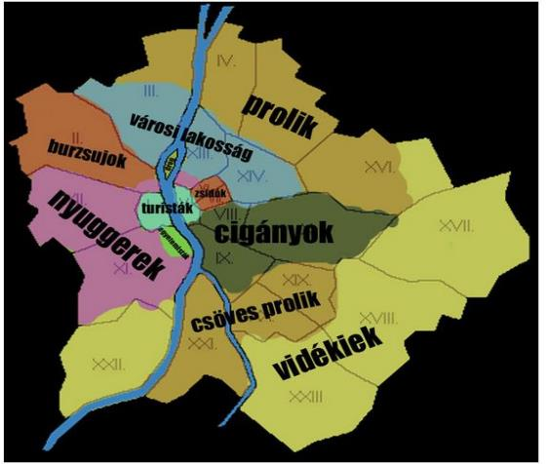
Talán nem is kell többet tudni….

Slide 5
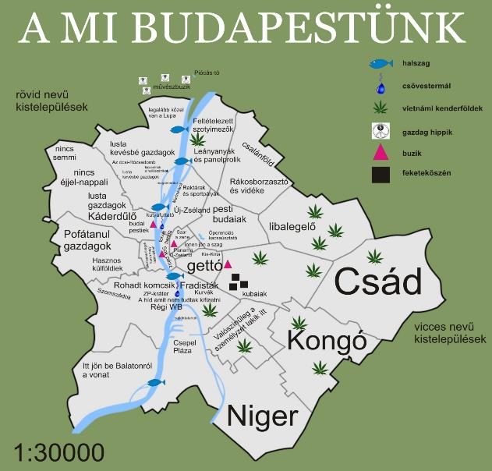

Slide 6
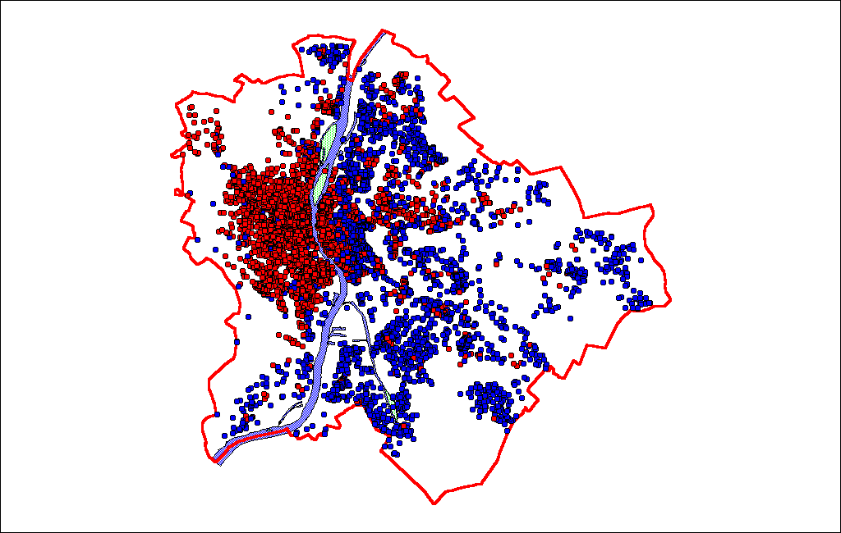

Slide 7
Ward-Clusters of town planning units with 11 social groups

Slide 8
Which modell? Analysis of variance
σ²_{t}=σ²_{b}+σ²_{w}
σ²_{t}= total variance
σ²_{b}= between group variance
σ²_{w}= within group variance
σ²_{b} / σ²_{t} = ε²

Slide 9
Grouping spatial units: nested analysis of variance
σ²_{t}= σ²_{b2}+σ²_{w12}
σ²_{b2}= σ²_{b3}+σ²_{w23}
σ²_{b3}= σ²_{b4}+σ²_{w34}
σ²_{t} =σ²_{w12}+σ²_{w23}+σ²_{w34}+σ²_{b4}
100 = 29 + 11 + 9 + 51

Slide 10
A lakóhelyi szegregáció dimenziói
Uneveness
Exposure
Concentration
Centralization
Clustering
D.S.Massey-N.A.Denton: Dimensions of Segregation
In: Social Forces Vol.67:2

Slide 11
UNEVENNESS
Index
D
G
H
A1
A5
A9
Name of Measure
Index of Dissimilarity
Gini Index
Entropy Index or Information Index
Atkinson Index with b=.10
Atkinson Index with b=.50
Atkinson Index with b=.90

Slide 12
Disszimilaritási mutató (Duncan-index)
Index of dissimilarity
_{n}
D=∑ [t_{i} ⎜p_{i} - P⎜/ 2TP(1-P)]
^{i=1}
t_{i,} and p_{i} are the total population and minority proportion of areal unit i,
T, P are the population size and minority proportion for the city

Slide 14
A Taeuber kritériumok
: 1) the “transfer principle”,
should be sensitive to the redistribution or “transfer” of minorities AMONG areal units with minority proportions above or below the metropolitan area’s minority proportion
(and not just transfers from areas above to areas below that proportion);
2) “compositional invariance”,
the relative size of minority population should NOT affect the index;
3) “size invariance”,
should not be affected if the number of people in each group is multiplied by a constant;
4) “organizational equivalence”
index should be unaffected by aggregating units with the same minority composition.

Slide 15
Correlations
 |  | DISS_ertel_11 | GINI_ertel_11 | ENTR_ertel_11 | ATKI_ertel_11 | INTE_ertel_11 | ISOL_ertel_11 | COR_ertel_11
DISS_ertel_11 | Pearson Correlation | 1 | ,937** | ,984** | -,297** | ,800** | ,473** | ,718**
 | Sig. (2-tailed) |  | ,000 | ,000 | ,000 | ,000 | ,000 | ,000
 | N | 3154 | 3154 | 3154 | 3154 | 3154 | 3154 | 3154
GINI_ertel_11 | Pearson Correlation | ,937** | 1 | ,932** | -,306** | ,766** | ,501** | ,721**
 | Sig. (2-tailed) | ,000 |  | ,000 | ,000 | ,000 | ,000 | ,000
 | N | 3154 | 3154 | 3154 | 3154 | 3154 | 3154 | 3154
ENTR_ertel_11 | Pearson Correlation | ,984** | ,932** | 1 | -,203** | ,732** | ,445** | ,744**
 | Sig. (2-tailed) | ,000 | ,000 |  | ,000 | ,000 | ,000 | ,000
 | N | 3154 | 3154 | 3154 | 3154 | 3154 | 3154 | 3154
ATKI_ertel_11 | Pearson Correlation | -,297** | -,306** | -,203** | 1 | -,807** | -,738** | -,363**
 | Sig. (2-tailed) | ,000 | ,000 | ,000 |  | ,000 | ,000 | ,000
 | N | 3154 | 3154 | 3154 | 3154 | 3154 | 3154 | 3154
INTE_ertel_11 | Pearson Correlation | ,800** | ,766** | ,732** | -,807** | 1 | ,732** | ,656**
 | Sig. (2-tailed) | ,000 | ,000 | ,000 | ,000 |  | ,000 | ,000
 | N | 3154 | 3154 | 3154 | 3154 | 3154 | 3154 | 3154
ISOL_ertel_11 | Pearson Correlation | ,473** | ,501** | ,445** | -,738** | ,732** | 1 | ,791**
 | Sig. (2-tailed) | ,000 | ,000 | ,000 | ,000 | ,000 |  | ,000
 | N | 3154 | 3154 | 3154 | 3154 | 3154 | 3154 | 3154
COR_ertel_11 | Pearson Correlation | ,718** | ,721** | ,744** | -,363** | ,656** | ,791** | 1
 | Sig. (2-tailed) | ,000 | ,000 | ,000 | ,000 | ,000 | ,000
 | N | 3154 | 3154 | 3154 | 3154 | 3154 | 3154 | 3154
**. Correlation is significant at the 0.01 level (2-tailed).

Slide 16
 |  | DISS_sm_01 | GINI_sm_01 | ENTR_sm_01 | ATKI_sm_01 | INTE_sm_01 | ISOL_sm_01 | COR_sm_01
DISS_sm_01 | Pearson Correlation | 1 | ,795** | ,926** | ,308** | ,317** | ,205** | ,399**
 | Sig. (2-tailed) |  | ,000 | ,000 | ,000 | ,000 | ,000 | ,000
 | N | 3153 | 2940 | 3153 | 3153 | 3153 | 3153 | 3153
GINI_sm_01 | Pearson Correlation | ,795** | 1 | ,759** | ,757** | -,132** | ,132** | ,363**
 | Sig. (2-tailed) | ,000 |  | ,000 | ,000 | ,000 | ,000 | ,000
 | N | 2940 | 2940 | 2940 | 2940 | 2940 | 2940 | 2940
ENTR_sm_01 | Pearson Correlation | ,926** | ,759** | 1 | ,400** | ,193** | ,391** | ,637**
 | Sig. (2-tailed) | ,000 | ,000 |  | ,000 | ,000 | ,000 | ,000
 | N | 3153 | 2940 | 3153 | 3153 | 3153 | 3153 | 3153
ATKI_sm_01 | Pearson Correlation | ,308** | ,757** | ,400** | 1 | -,778** | -,237** | ,150**
 | Sig. (2-tailed) | ,000 | ,000 | ,000 |  | ,000 | ,000 | ,000
 | N | 3153 | 2940 | 3153 | 3153 | 3153 | 3153 | 3153
INTE_sm_01 | Pearson Correlation | ,317** | -,132** | ,193** | -,778** | 1 | ,253** | ,015
 | Sig. (2-tailed) | ,000 | ,000 | ,000 | ,000 |  | ,000 | ,397
 | N | 3153 | 2940 | 3153 | 3153 | 3153 | 3153 | 3153
ISOL_sm_01 | Pearson Correlation | ,205** | ,132** | ,391** | -,237** | ,253** | 1 | ,832**
 | Sig. (2-tailed) | ,000 | ,000 | ,000 | ,000 | ,000 |  | ,000
 | N | 3153 | 2940 | 3153 | 3153 | 3153 | 3153 | 3153
COR_sm_01 | Pearson Correlation | ,399** | ,363** | ,637** | ,150** | ,015 | ,832** | 1
 | Sig. (2-tailed) | ,000 | ,000 | ,000 | ,000 | ,397 | ,000
 | N | 3153 | 2940 | 3153 | 3153 | 3153 | 3153 | 3153

Slide 17
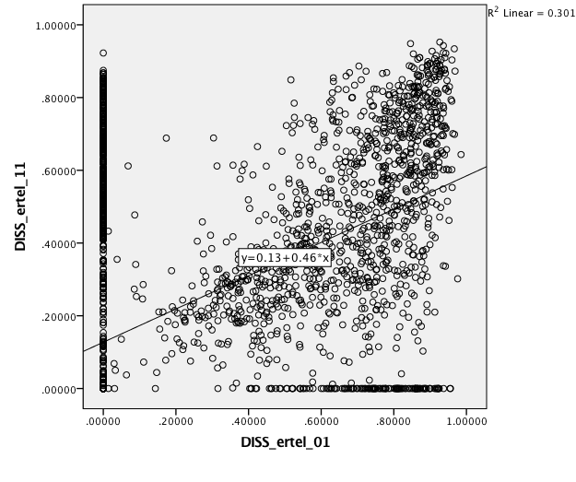
Disszimilaritási együtthatók értelmiség 2001-2011

Slide 18
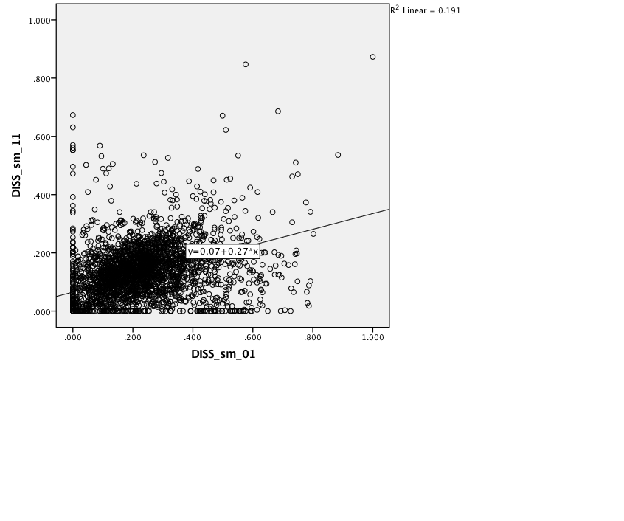
Disszimilaritási együtthatók Kvalifikálatlan fizikai 2001-2011

