Slide 1



Europe through an Irish Lens: Development, Progress, Regress
Seán Ó Riain
Sociology/ National Institute for Regional and Spatial Analysis,
National Univ of Ireland, Maynooth

Slide 2
Development, Progress, Regress: Europe through an Irish Lens
‘Convergence’ on a European Development Model in the 1990s?
Expanding the European Model I: Liberalisation and Financialisation
Expanding the European Model II: Deregulation and Discipline
Europe’s Crisis and the Crisis of European Development

Slide 3
Europe and ‘Autocentric Development’ (Senghaas/ Mjoset)
National System of Innovation
Linking of Export and Domestic Economies
Egalitarian Social Structure and Class Compromise
Spread of Mass Consump-tion

Slide 4
Uneven Development inside the ‘European Project’
 | EU | Euro
Germany, France, Italy, Belgium, Neth, Lux | 1951 | 1999
Austria | 1995 | 1999
Denmark | 1973 | -
Sweden | 1995 | -
Finland | 1995 | 1999
Norway | - | -
UK | 1973 | -
Ireland | 1973 | 1999
Greece | 1981 | 2001
Spain, Portugal | 1986 | 1999
Cyprus, the Czech Republic, Hungary, Latvia, Lithuania, Malta, Poland | 2004 | -
Cyprus, Estonia, Malta, Slovakia, Slovenia | 2004 | 2007-11
Bulgaria, Romania | 2007 | -

Slide 5
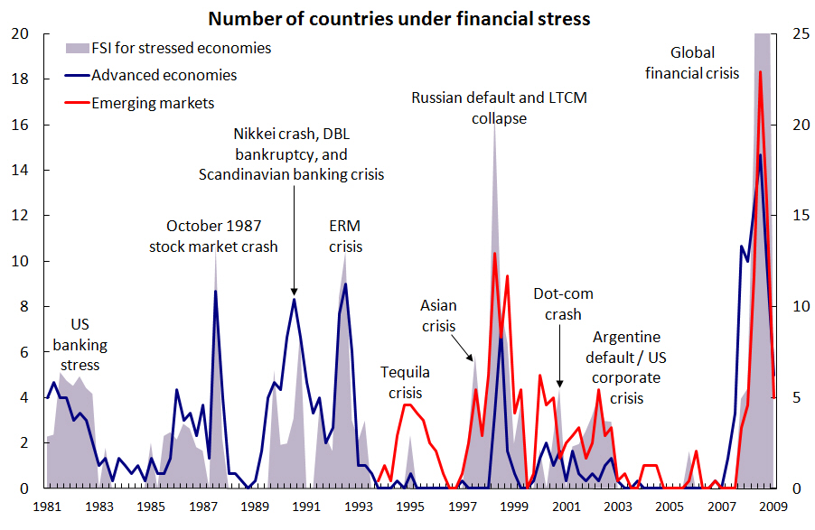
Development as a Condition of Stability in Capitalism (Chart from IMF)

Slide 6
1. Development in Ireland’s Celtic Tiger: ‘Convergence’ and ‘Choice’
Develop-mental Network State
Disarticulated/ Fragmented Economy
Solidarity without Equality
Expanded demand and employment

Slide 7
2A. Ireland’s Property Bubble
INVESTMENT – BUILDING/NON-BUILDING PROPORTION OF LENDING TO REAL ESTATE

Slide 8
2B. International Lending and the Bubble
Net foreign liabilities of Irish banks (% of total liabilities) (Lane, 2011)

Slide 9
2C. Core Finance Goes International
DOMESTIC CREDIT AND INTL LENDING IN FRANCE AND GERMANY (% OF GDP)

Slide 10
2D. Turning Europe Inside Out
% OF TOTAL EXPORTS AND TOTAL DEMAND IN EUROZONE

Slide 11
3A. Dynamism through ‘Liberal Convergence’? (OECD Indices)
EMPLOYMENT PROTECTION PRODUCT MARKET REGULATION

Slide 12
3B. Discipline through ‘Christian Democratic Convergence’? (Guillen, Visser indices)
CENTRAL BANK INDEPENDENCE WAGE COORDINATION

Slide 13
3C. Persistent Differences in Social Compacts
 | Average Fiscal Balance 1999-2007 (% ‘potential’ GDP) | Average Business R&D Investment 1999-2007 (% GDP) | % ‘Learning’ Organisation of Work, 2000 (Lorenz & Valeyre) | Social Spending, 2002 (% GDP)
Nordics/ Social Democratic | 0.3 | 2.26 | 53 | 36.6
Continentals/ Christian Democratic | -1.7 | 1.42 | 47 | 32.5
Mediterranean | -4.0 | 0.40 | 24 | 26.6
Liberal | -2.5 | 0.97 | 29 | 27.5
Including: Ireland | -2.7 | 0.80 | 24 | 27.0

Slide 14
4A. The Double Movement in Liberal Political Economies
Unequal market power
Weak credible commitments to security, protection and investment
Keynesianism
Wage Earner Welfare State
Wage and Market Income as Focus of Demands
Tax Redistribution of Income

Slide 15
4B. The Double Movement in the European Core
More equal empowerment of market actors
Strong credible collective commitments
Investment Centred
Universalist Protection
Wages Less Significant Part of Welfare
Distribution of Welfare through Services

Slide 16
Can the ‘European Model’ survive the ‘European Solution’?
KEYNESIAN DEVELOPMENT NOW,
DEVELOPMENT WITH DISCIPLINE LATER?
LACK OF CREDIBLE
COMMITMENTS
WEAK AUTHORITY
FISCAL TREATY
AUSTERITY UNDERMINES DEVELOPMENT
WEAKENING EUROPEAN SOLIDARITY

